Slide 1
AI and AWS
Larry Huynh CITS5503, S2 2024

Slide 2
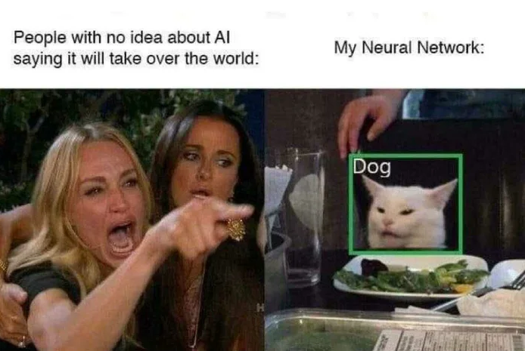
Is AI taking over human jobs? Is it true that AI is becoming the dominant form of intelligence on Earth? Will it take control of the planet?

Slide 3
What is AI?
Artificial Intelligence
AI: is about making machines act like humans.
Machine Learning: extract knowledge from data and learn from it autonomously. Deep Learning: uses neural network models that mimic biological brain structures and enhance the automation of training AI models.
Machine Learning
Deep Learning

Slide 4
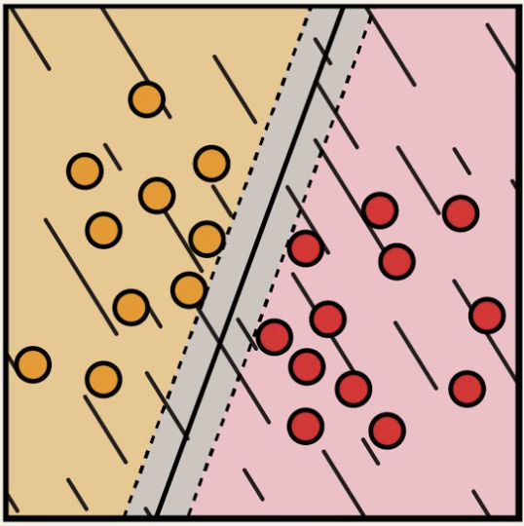
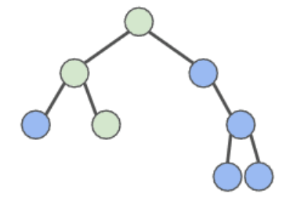
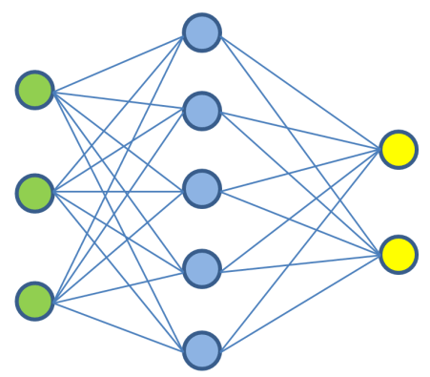
Question Answering
Text
Sentiment Analysis
Images
Information Extraction
Training
Model
Adaptation
Speech
Image Caption
Tabular Data
Object Recognition
…
3D signals
Instruction Following
Support Vector Machine
Random Forest
Neural Network

Slide 5
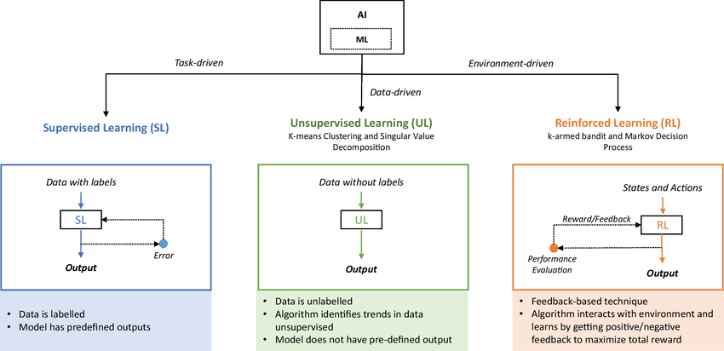
Types of Machine Learning

Slide 6
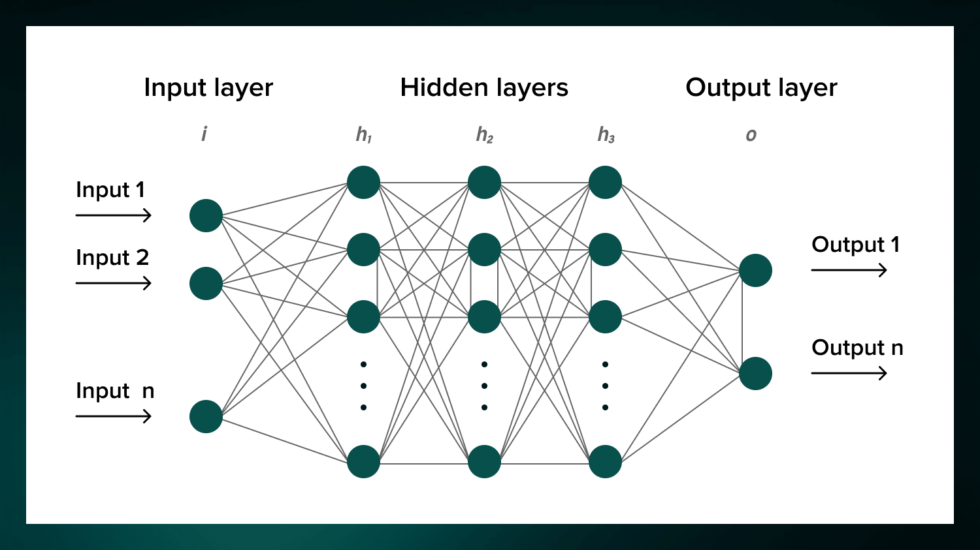
Neural Network Infrastructure

Slide 7
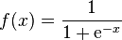
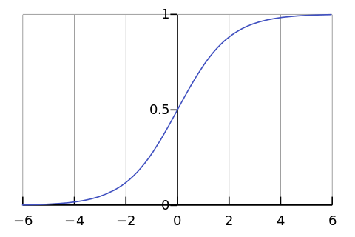
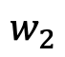
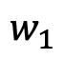
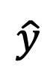
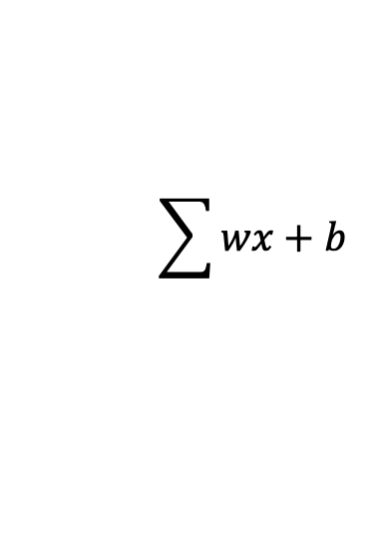
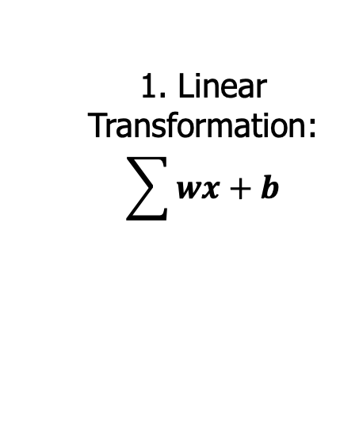
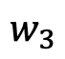
Perceptron (Single node neural network)
1. Linear Transformation: $$\sum{wx+b}$$
2. Non-linear Transformation (Activation Function)
x₁
$$w_{1}$$
x₂
$$w_{2}$$
$$\sum{wx+b}$$
$$\hat{y}$$
Prediction
$$w_{3}$$
x₃

Slide 8
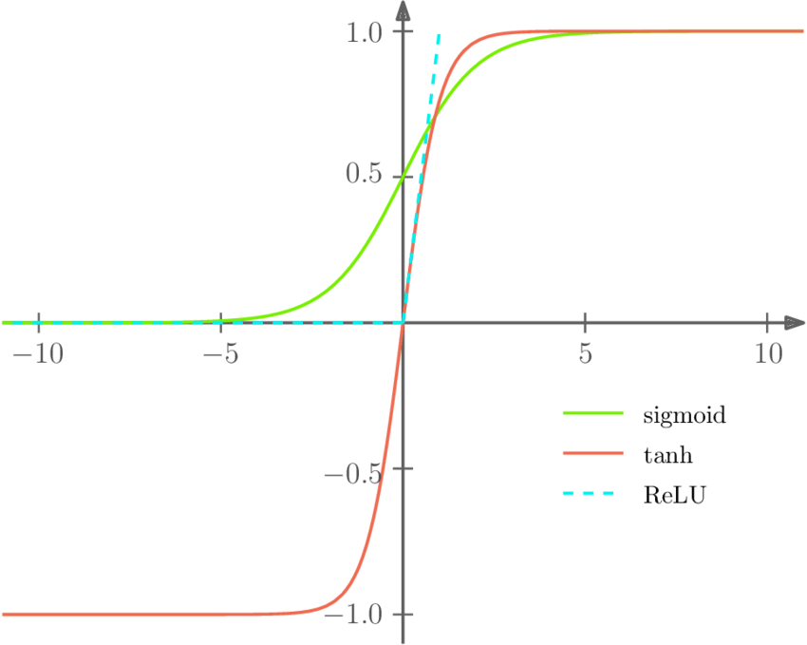
Activation Function

Slide 9
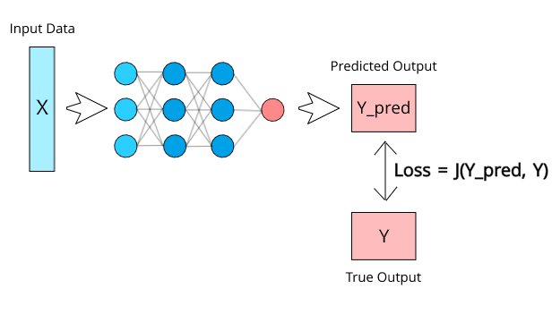
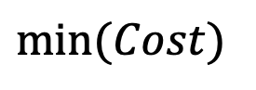
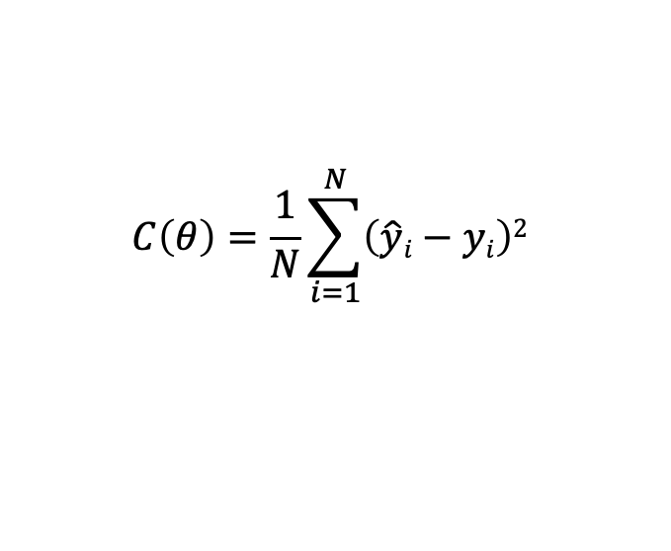
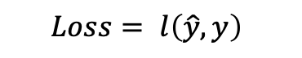
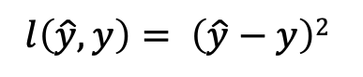
Calculating the Loss
Loss: the difference between the prediction and the actual value for the individual data instance.
Example Loss Function:
Cost: The aggregate of the losses of all data instances
Example Cost Function: θ are all the model parameters: w’s and b’s
Goal in training the model:
$$l\left(\hat{y}, y\right)= \left(\hat{y}−y\right)2$$
$$C\left(θ\right)=\frac{1}{N}\sum_{i=1}^{N}{\left(\hat{y}i−yi\right)2}$$
$$Loss= l\left(\hat{y}, y\right)$$
$$min⁡(Cost)$$

Slide 10
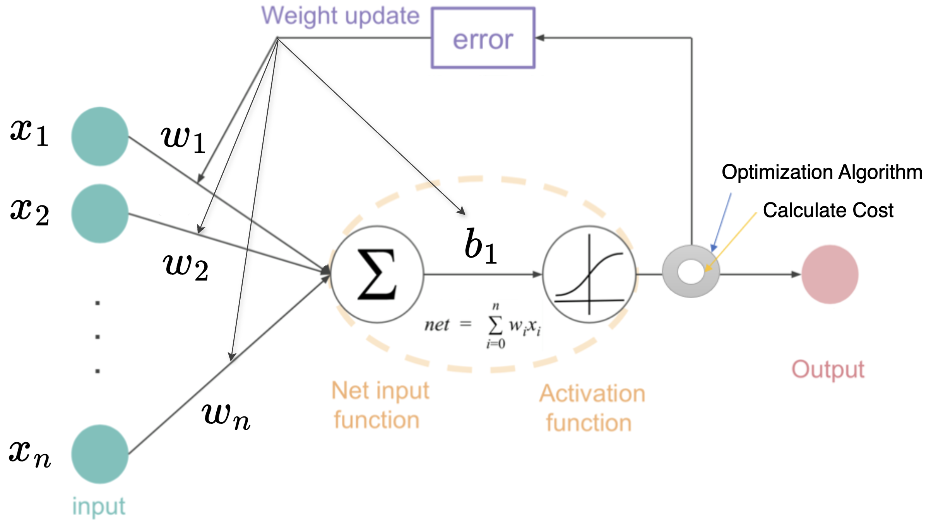
Backpropagation in Neural Networks
Objective: minimise the cost function, which represents the global error.
We need to update the parameters (w’s and b’s) such that the cost function is minimised → done via calculus: computing cost function derivatives.

Slide 11
Backpropagation in Neural Networks
Updates are done iteratively: optimization algorithms (such as gradient descent) adjust parameters step-by-step in the direction that reduces the cost function until convergence.

Slide 12
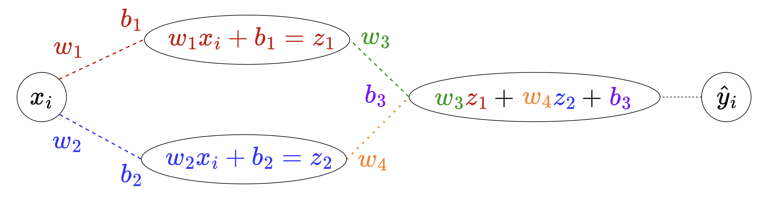
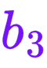
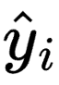
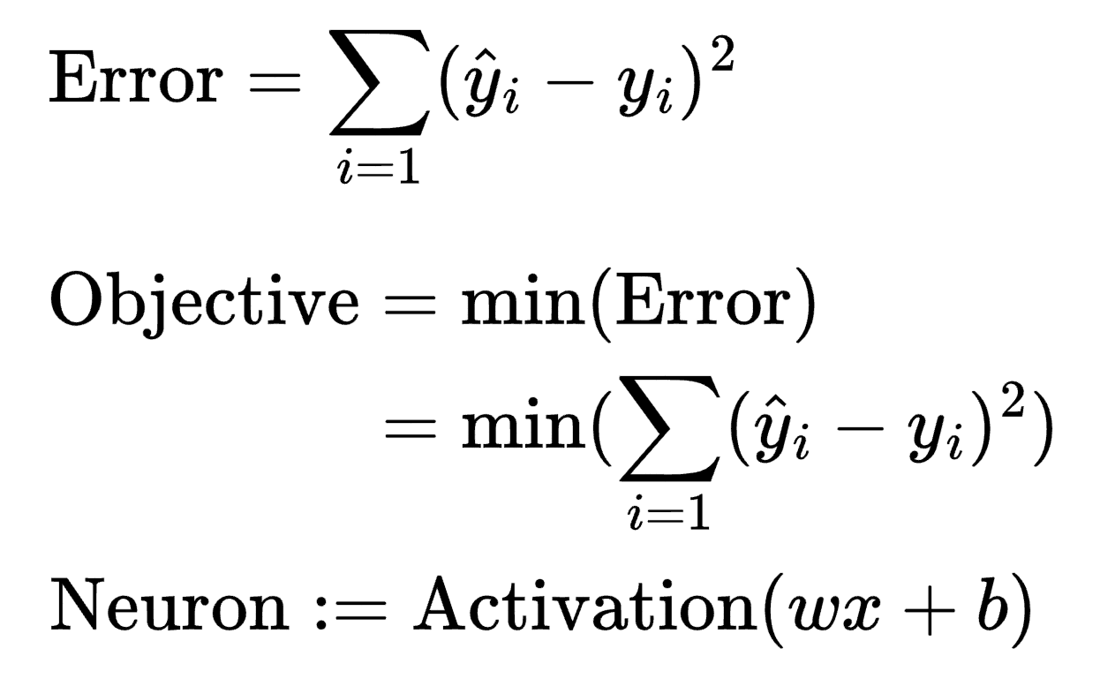
Backpropagation in Neural Networks
What does contribute to the outcome ?
How much do I need to change by to minimize the Error?
(Activation functions will be ignored for this example)

Slide 13
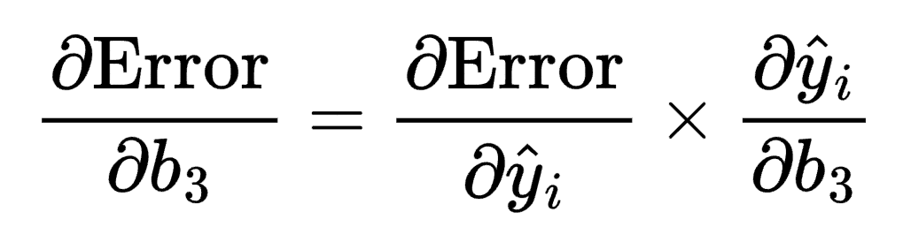
Backpropagation in Neural Networks
What does contribute to the outcome ?
How much do I need to change by to minimize the Error?
Use the Chain Rule!
(Activation functions will be ignored for this example)

Slide 14
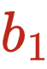
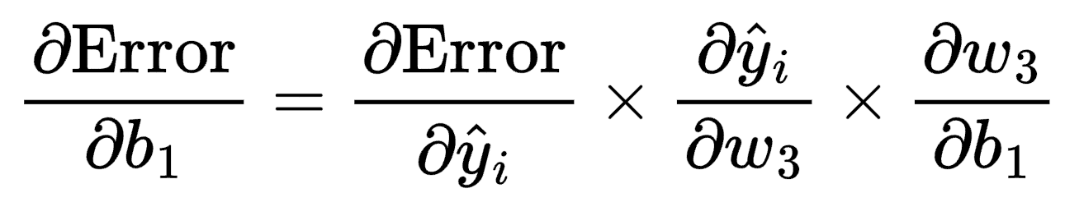
Backpropagation in Neural Networks
What about the changes to needed to minimize the Error?
Backpropagation algorithm these updates simultaneously in a single pass.
(Activation functions will be ignored for this example)

Slide 15
Metrics for Monitoring Model Performance
Accuracy:
Measure the percentage of correctly classified instances.
Precision:
Proportion of true positive predictions among all positive predictions.
“Out of all positive predictions, how many were correct?”
Recall:
Proportion of true positive predictions among all actual positive instances.
“Out of all actual positives, how many were correctly identified?”
F1 Score:
Harmonic mean of precision and recall, balancing both metrics.

Slide 16
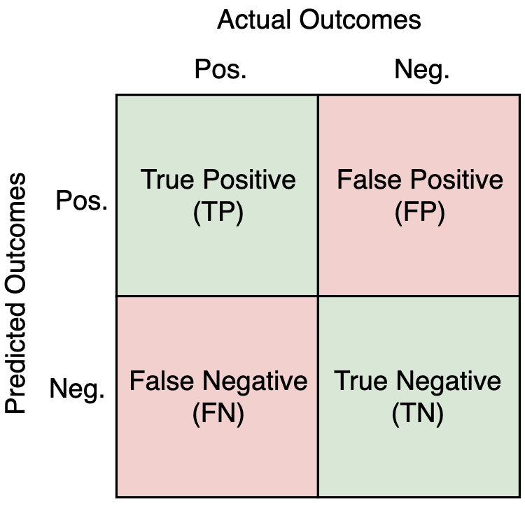
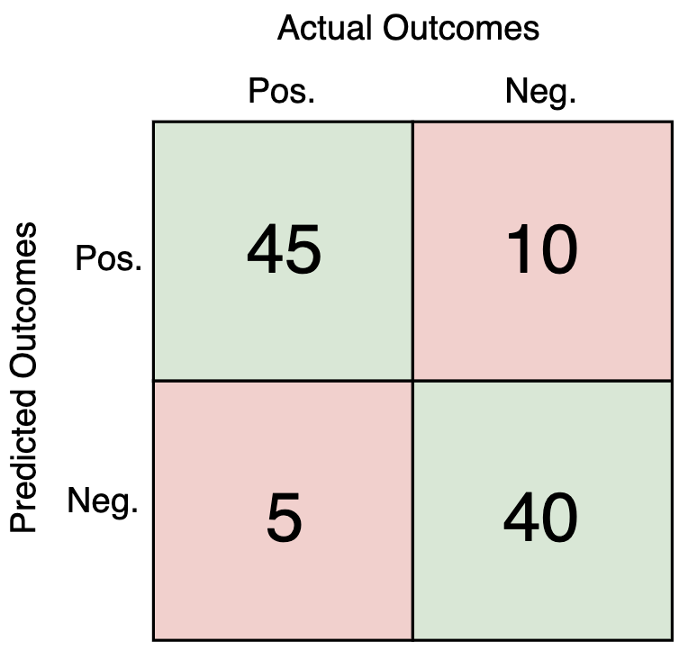
Metrics for Monitoring Model Performance
A confusion matrix is useful for calculating these metrics.
Example with 100 instances:
Accuracy = TP + TN / (TP + FP + FN + TN)
= 85 / 100 = 85%
Precision = TP / (TP + FP)
= 45 / 55 = 81.81%
Recall = TP / (TP + FN)
= 45 / 50 = 90%
F1 Score = 2 * Precision * Recall / (Precision + Recall)
= 2 * 0.8181 * 0.85 / (0.85 + 0.8181)
= 83.37%

Slide 17
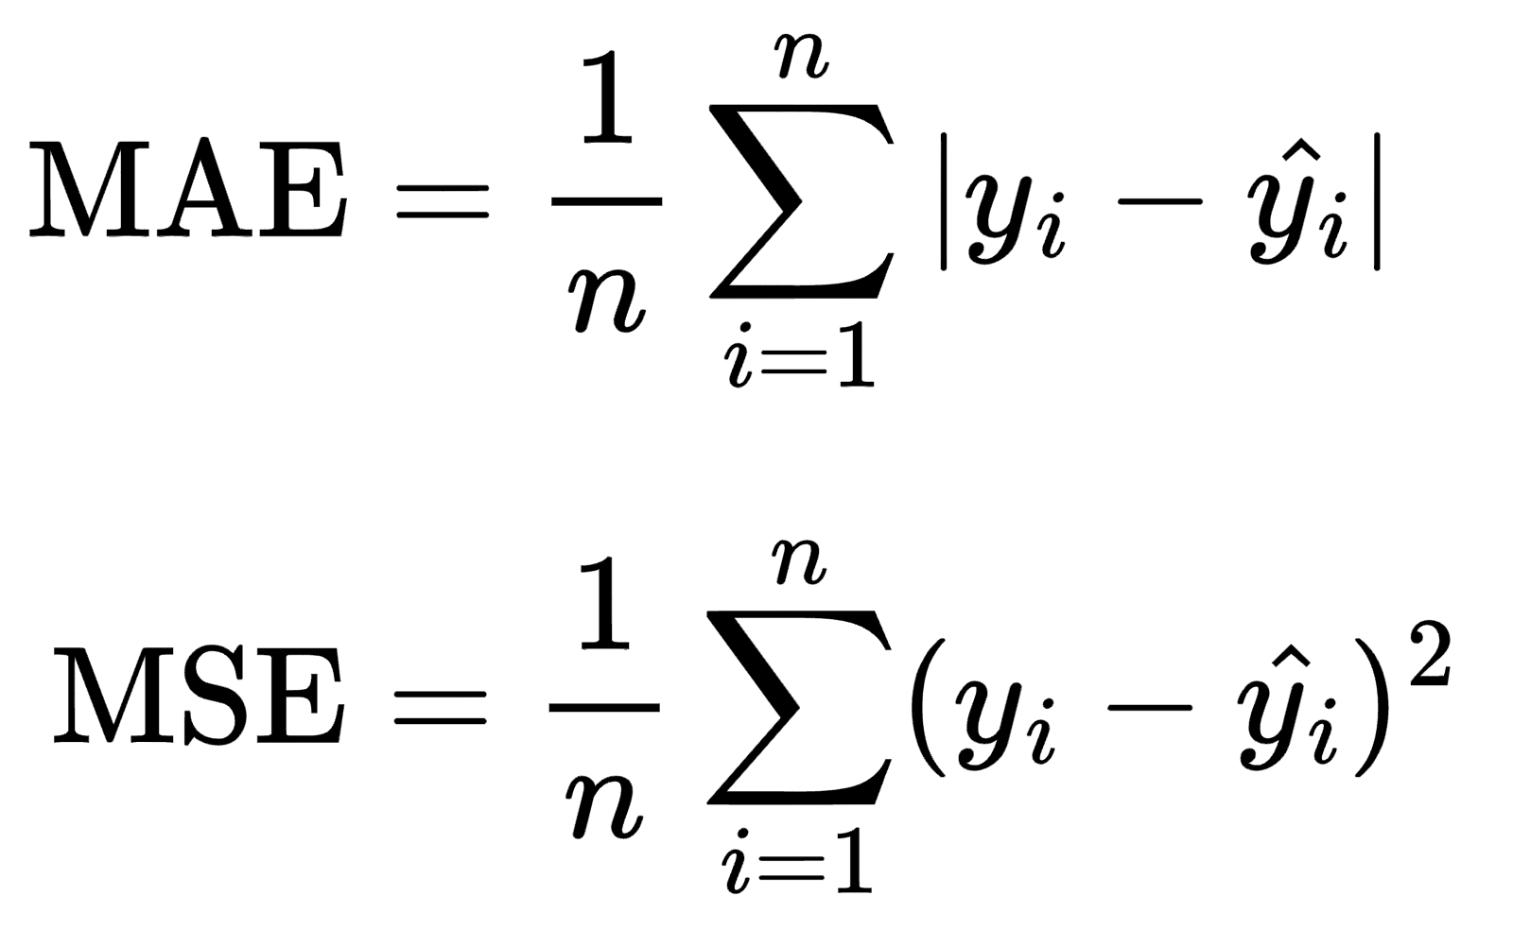
Metrics for Monitoring Model Performance
Mean Absolute Error (MAE):
Commonly used for regression tasks, it measures the average absolute difference between predicted and actual values.
Mean Squared Error (MSE):
Another regression metric, measures the average squared difference between predicted and actual values, giving higher weight to larger errors.
Cross-Validation Scores:
Assess model performance on multiple subsets of the data to check for overfitting and assess generalization.

Slide 18
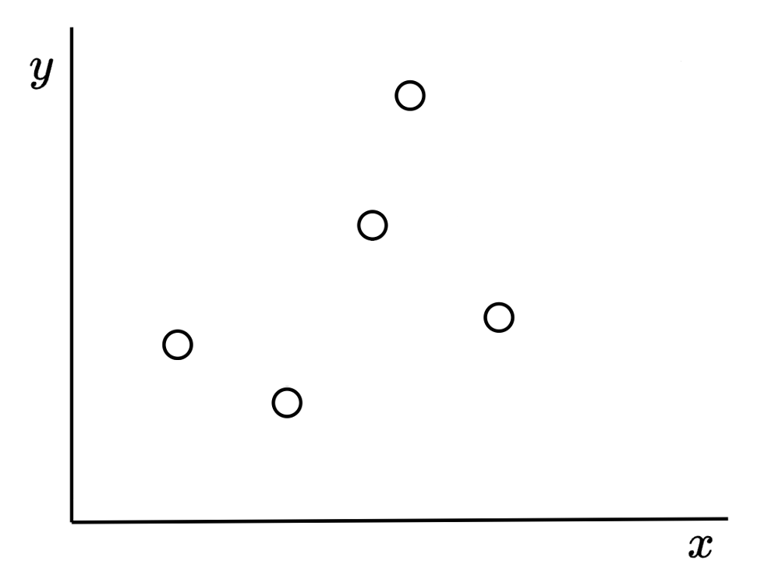
Metrics for Monitoring Model Performance
Example regression problem:
Dots are actual data points.

Slide 19
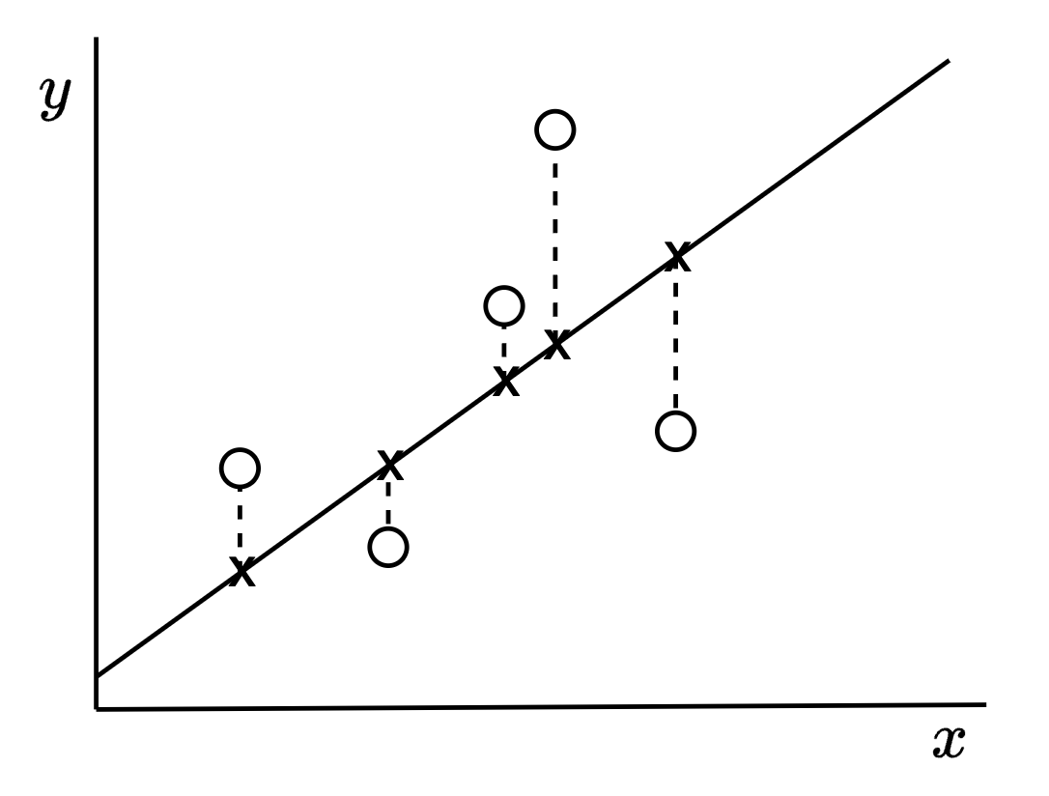
Metrics for Monitoring Model Performance
Example regression problem:
Dots are actual data points.
Line is the learned function (“line of best fit”).
X are the intercepts.

Slide 20
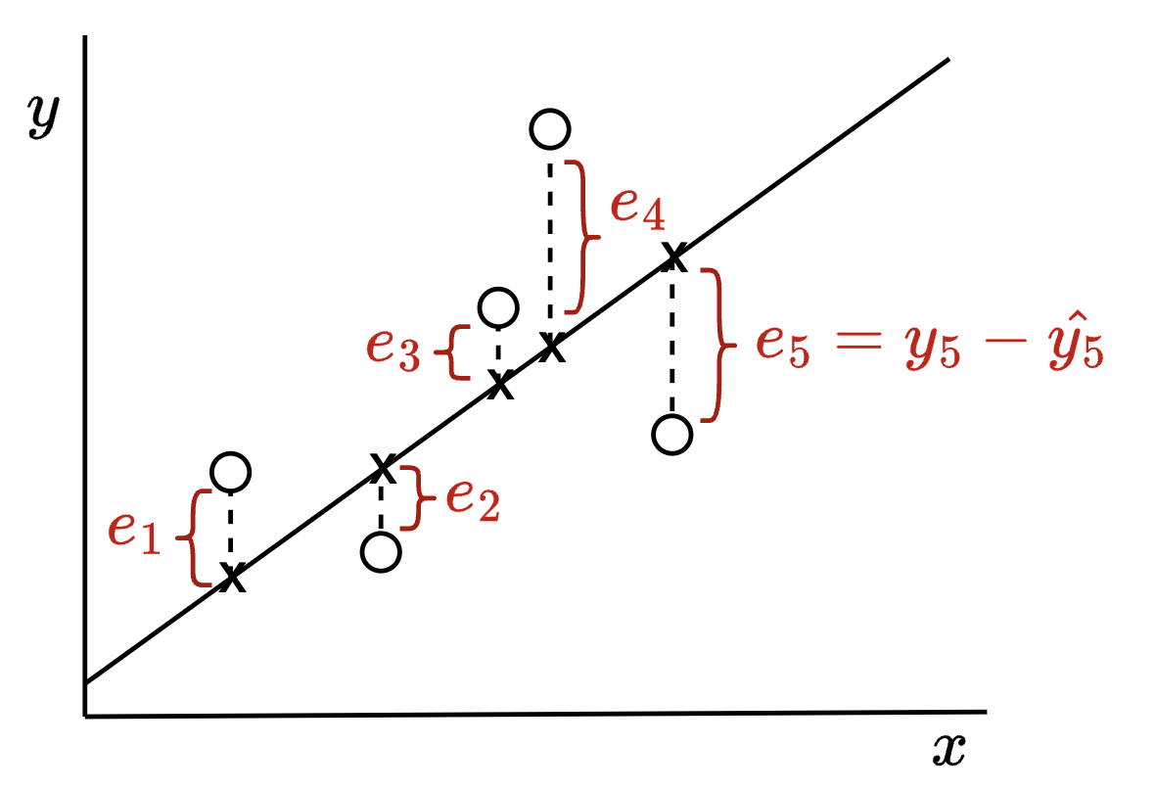
Metrics for Monitoring Model Performance
Errors e are the differences between the actual y and the predicted ŷ
You can see how the MSE penalises larger errors.

Slide 21
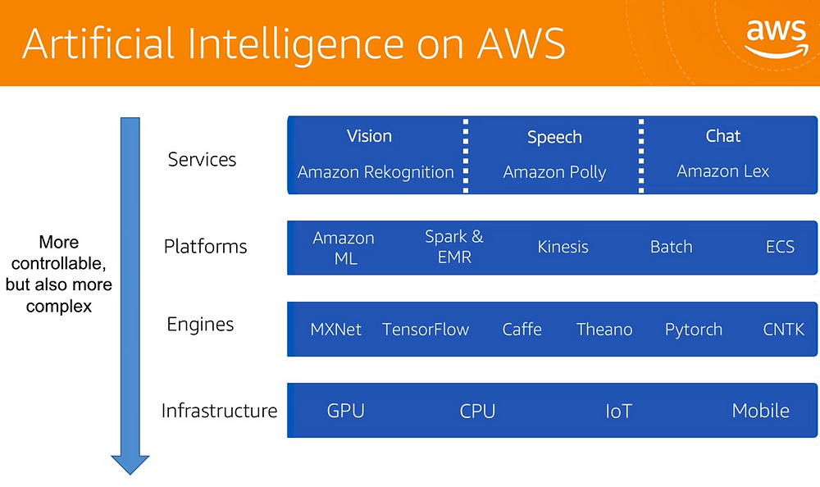

Slide 22
AWS Inference-as-a-Service (IaaS) Models
Models that have been trained and deployed by AWS; end users only need to query the model for predictions on their supplied data.
A few examples:
AWS Comprehend:
Analyzes text and documents and provides information on:
Entities, key phrases, language, sentiments, etc.

Slide 23
AWS Inference-as-a-Service (IaaS) Models
Models that have been trained and deployed by AWS; end users only need to query the model for predictions on their supplied data.
A few examples:
AWS Rekognition:
Image and video recognition service. Is able to extract various information:
Object and scene detection,
Face detection,
Text-in-image detection,
Etc.

Slide 24
Amazon SageMaker
Simplifies the process of building, training, and deploying machine learning models.
Jupyter Notebooks in the SageMaker Web UI
Provides a fully managed Jupyter notebook environment for writing and executing code, visualizing data, and documenting your work.
Automatically handles the creation and management of underlying infrastructure (machines and containers) to run your code.
Flexibility with Code-Only Interaction
Interact with SageMaker entirely through code using the AWS SDK for Python (Boto3) or the SageMaker Python SDK.
Create custom Docker containers with your own code and dependencies, and run them on SageMaker's managed infrastructure.

Slide 25
Machine Learning Pipeline Tasks with AWS
Preparing your Environment
Task Definition and Data Preparation
Model Selection
Data Pre-processing
Training and Hyperparameterisation
Evaluation
Deployment and Inference
We’ll explore these tasks with a worked demo using Sagemaker.

Slide 26
1. Preparing your Environment
Hardware and Software Requirements: Ensure you have access to a suitable environment for training.
AWS EC2 Instances, S3 buckets, EBS, etc., and associated policies.
Amazon Elastic Inference: Elastic Inference allows you to attach low-cost GPU-powered inference acceleration to your EC2 instances.
Amazon CloudWatch: CloudWatch provides monitoring and logging
Install Required Libraries: Use Pip to install the necessary Python libraries. Common libraries:
NumPy and Pandas (data manipulation)
Matplotlib and Seaborn (visualisation)
Scikit-learn (for ML) TensorFlow or PyTorch (for deep learning).

Slide 27
1. Preparing your Environment
Setup configuration:
AWS credentials and region.
Configure sagemaker session using boto3.

Slide 28
2. Task Definition and Data Preparation
Task Definition:
What is the problem to solve, and what business logic do we need to do so?
Data Domain: image, text, audio, tabular?
Task: classification, regression, generative outcomes?
Data Collection:
Identify and gather relevant data sources (e.g., databases, APIs, web scraping).
Ensure the data is clean, accurate, and representative of the problem domain.
(Try to) collect sufficient data to train robust models, considering the complexity of the task.

Slide 29
3. Model Selection
What model are we going to use?
Certain ML/AI models work best in specific contexts (below is a generalisation):
Convolution Neural Networks (CNNs) are ideal for images.
Sequence models (LSTM, RNN, Transformers) are ideal for text.
Tree-based models (Random Forests, Boosting models) are suitable for tabular, non-structured data.
Evaluate Costs Involved
Select the size of the model that is appropriate for the scale of your data, and your budget.
More data = larger models = higher costs.

Slide 30
4. Data Preprocessing
Steps needed to prepare data for ML
Handling missing values. Common strategies are:
Removal: Discard the entire datapoint or feature with missing values.
Imputation: Replace missing values with substitutes (e.g., mean, median, mode, or predicted values).
Standardization and Normalisation:
Ensure features are on a comparable scale, crucial for many machine learning algorithms.
Standardization: Centres data by removing the mean and scales it by dividing it by the standard deviation.
Normalization: Rescales data to a fixed range, typically [0, 1], which is helpful for algorithms like neural networks that are sensitive to the scale of input data.
Some preprocessing steps are data format-specific:
Text: tokenisation, stop-word removal, stemming/lemmatization, etc.
Tabular Data: encoding categorical values, etc.

Slide 31
5. Training and Hyperparameterisation
Model ingests your data and extracts patterns/knowledge from it, and updates these beliefs iteratively as more data is feed through.
Important considerations:
Loss Function: Define a loss function that calculates the error between model predictions and ground truth.
Optimizer: Choose an optimizer such as Adam or RMSprop to update the model's weights during training.
Training Loop: Implement a training loop that iterates through your dataset.
Validation: Periodically evaluate your model on a validation dataset to check its performance during training.

Slide 32
5. Training and Hyperparameterisation
Hyperparameters: settings that control the learning process.
The hyperparameters and their values depend on your specific task and dataset.
For neural networks, some to consider:
Batch size: the number of training samples utilized in one forward and backward
Learning rate: controls the step size or rate at which a machine learning model updates its internal parameters during training.
Number of training epochs: passes through the entire training dataset

Slide 33
6. Evaluation
Test Data: evaluate your fine-tuned model on a separate test dataset.
Metrics: Calculate and report relevant evaluation metrics for your specific task.
Accuracy, Precision, Recall, F1, AUC, etc.
Loss per epoch
Monitoring: Continuously monitor your training and evaluating process.
Debugging: If your model isn't performing as expected, check your data, preprocessing, and model architecture for issues.

Slide 34
7. Deployment and Inference
Model Deployment
Make a trained model available for use in a production environment.
Deploy models to endpoints for real-time or batch predictions. Users can then access the model via the endpoint(s).
In AWS, models are deployed to EC2 instances; AWS tools help with handling varying levels of traffic, scaling up or down as needed.
Inference
Applying a trained machine learning model to new, unseen data to generate predictions or decisions.
Real-Time Inference: Process input data and return predictions instantly, ideal for applications requiring immediate responses.
Batch Inference: Process large volumes of data in batches, suitable for scenarios where real-time predictions are not necessary.

Slide 35
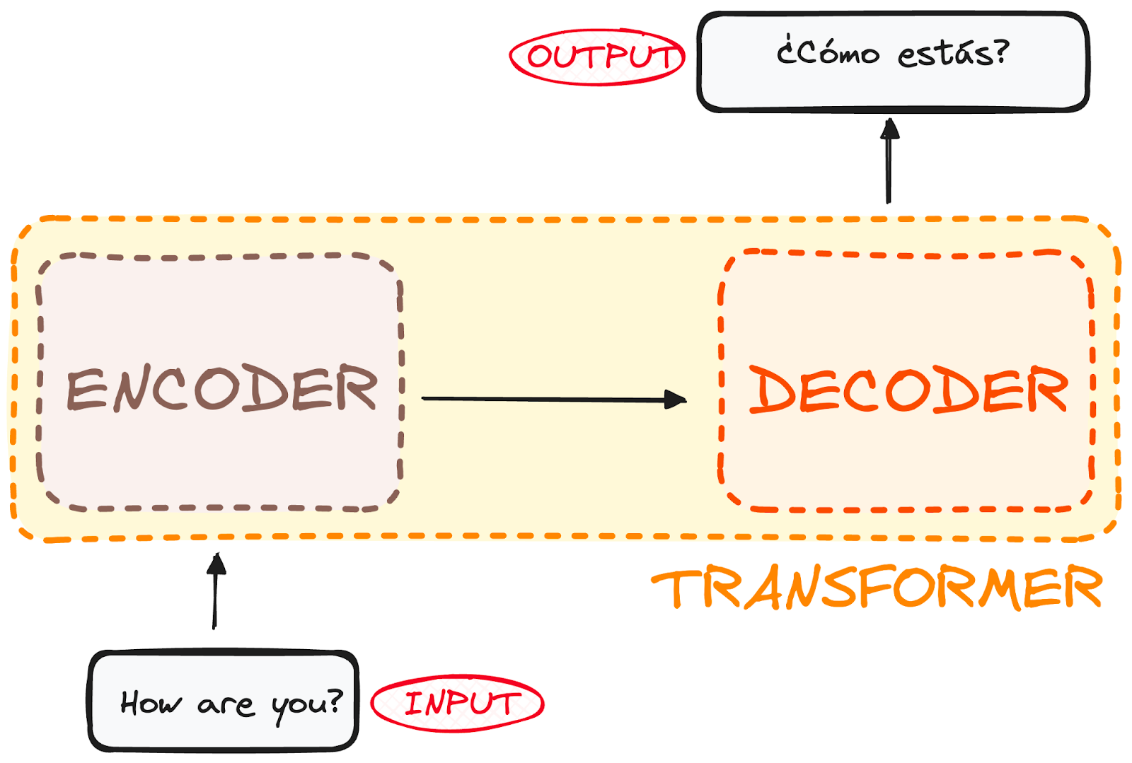
Transformer Models
Powerful, neural network models that Large Language Models (LLMs) are based on.
Popular LLMs: ChatGPT, Claude, Co-Pilot, etc.
Uses an encoder-decoder (1) architecture with an attention (2) mechanism:
(1) Transforms sequences of one context into another (e.g. translation task);
(2) Captures long-range dependencies and relationships between elements in the sequence

Slide 36
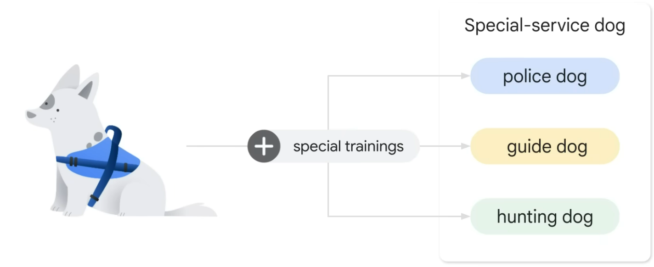
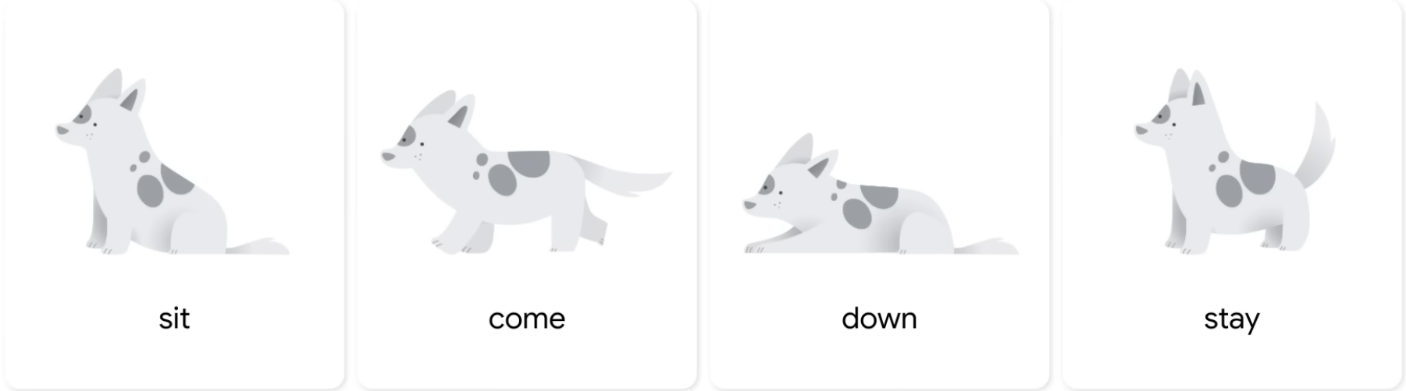
Transformer Models
LLMs are:
Large: huge training datasets, and huge model parameters used to develop them.
General purpose: the models are sufficient at solving a wide range of common problems.
Often Prompt-based: you interact with the model by giving it a user input query.
Pre-trained and fine-tuned.
“Pre-trained”: General Purpose Dog
“Fine-tuned”: Special Purpose Dog

Slide 37
Fine-Tuning
Further train a pre-trained model on a new, related dataset by unfreezing some or all of the pre-trained layers.
Allows the model to learn task-specific features while retaining general knowledge from the original dataset.
Effective when the new dataset is large and closely related to the original dataset.

Slide 38
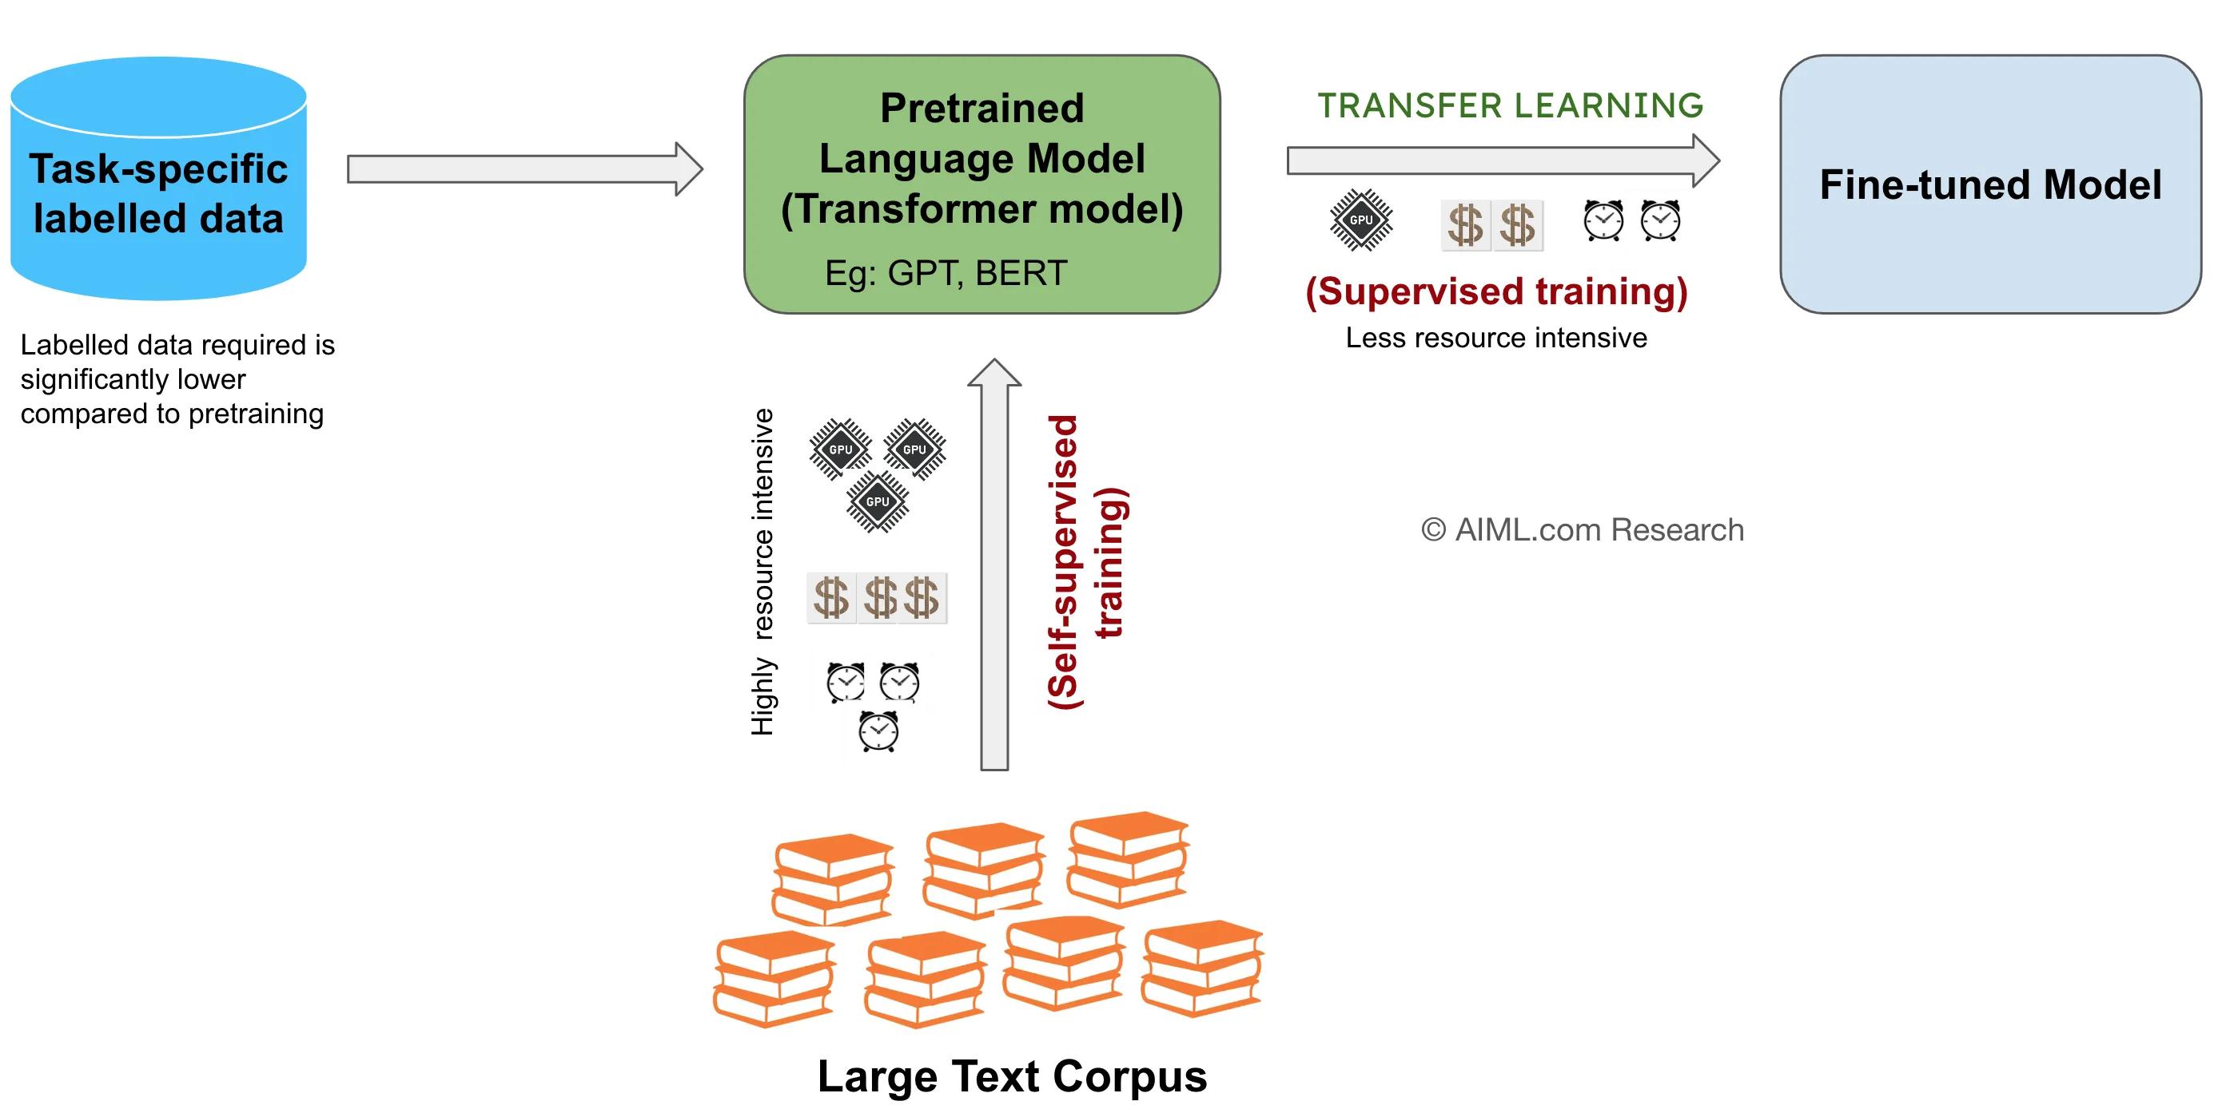
Fine-Tuning
Further train a pre-trained model on a new, related dataset by unfreezing some or all of the pre-trained layers.
Allows the model to learn task-specific features while retaining general knowledge from the original dataset.
Effective when the new dataset is large and closely related to the original dataset.

Slide 39
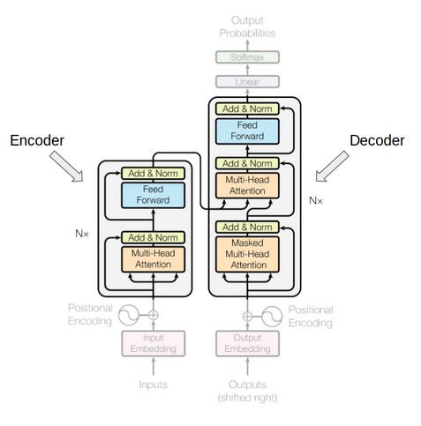
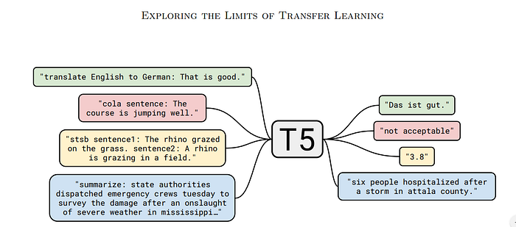
SageMaker Jumpstart for fine-tuning Google’s FLAN T5 Transformer Model
Jumpstart makes it easy!

Slide 40
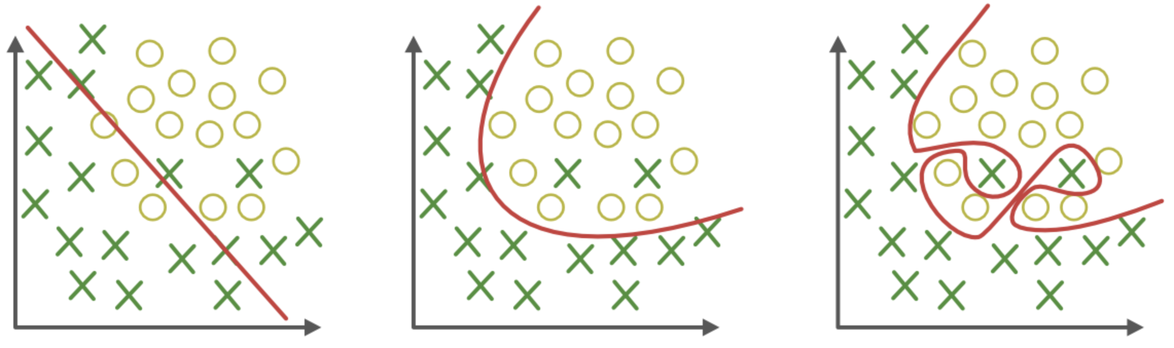
AI/ML Pitfalls
Overfitting
The model cannot generalize and fits too closely to the training dataset, and cannot predict new data well; it performs well on training data but poorly on unseen data.
Often due to noisy data, using too small of a training dataset, or using too complex of a model relative to the data.
Underfitting
Just Right
Overfitting

Slide 41
AI/ML Pitfalls
Underfitting
Model fails to capture patterns and does not learn the underlying trend in the data, leading to poor performance on both training and test data.
Often due to using too few parameters, or overly simplistic assumptions, or not training a sufficiently complex model for long enough.
Underfitting
Just Right
Overfitting

Slide 42
AI/ML Pitfalls
Insufficient Data Preprocessing
Failing to clean, transform, or prepare data before training properly.
Not handling missing values, including strong outliers, not applying proper scaling, etc.
Leads to the model capturing incorrect patterns, noise, or irrelevant features.
Inappropriate Model Selection
Choosing a model that does not align with the nature of the data or the problem at hand.
Leads to suboptimal performance (overfitting or underfitting).

Slide 43
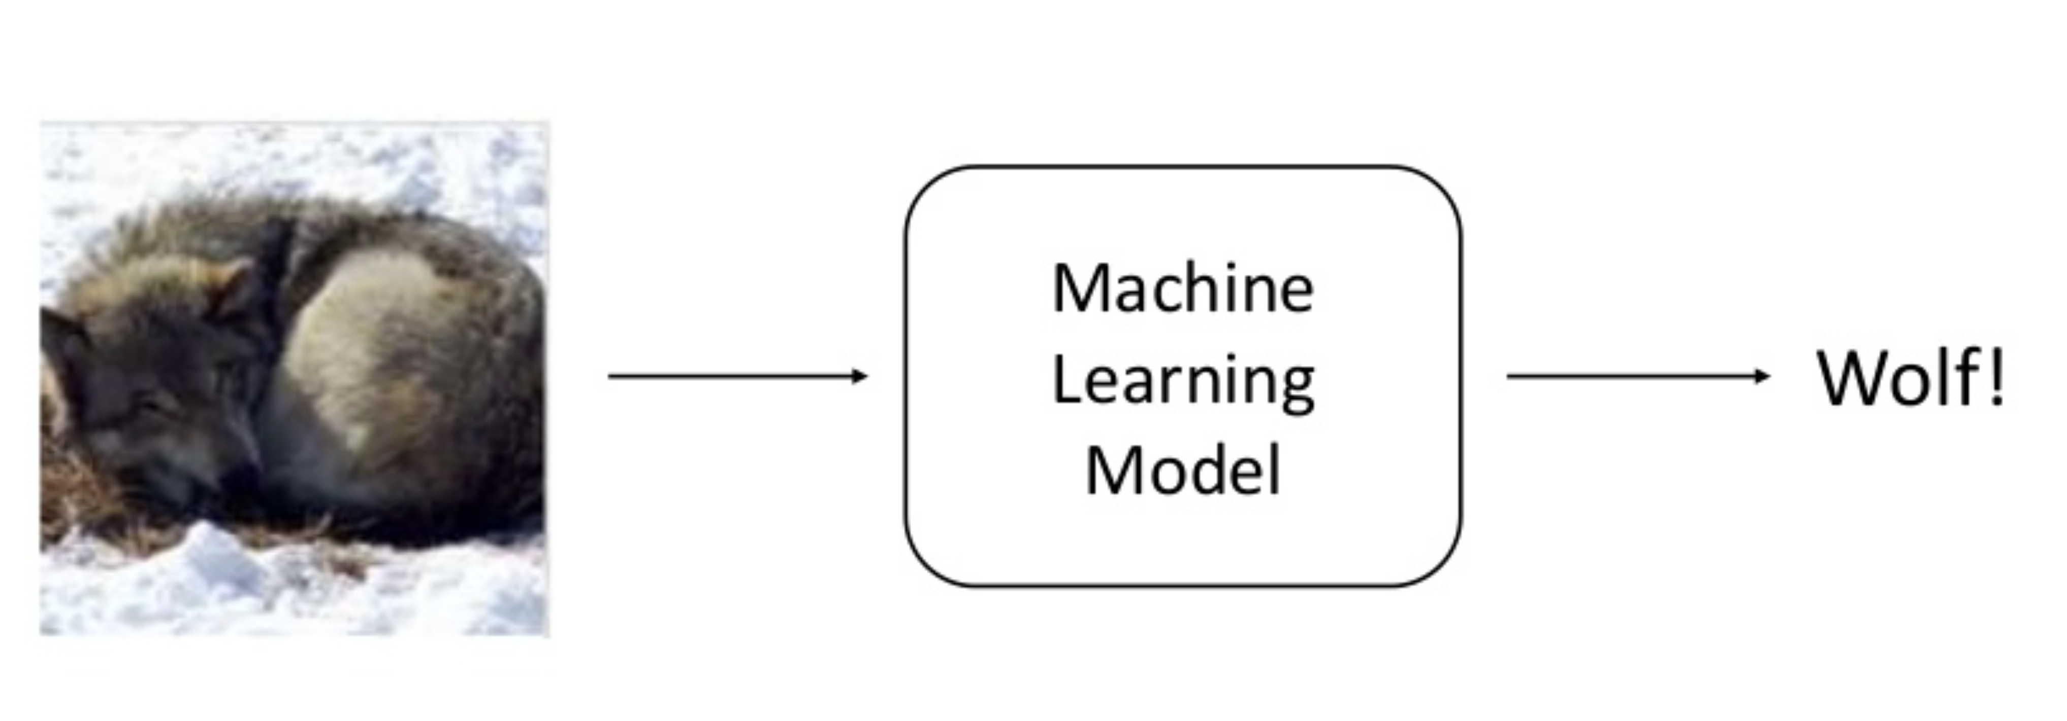
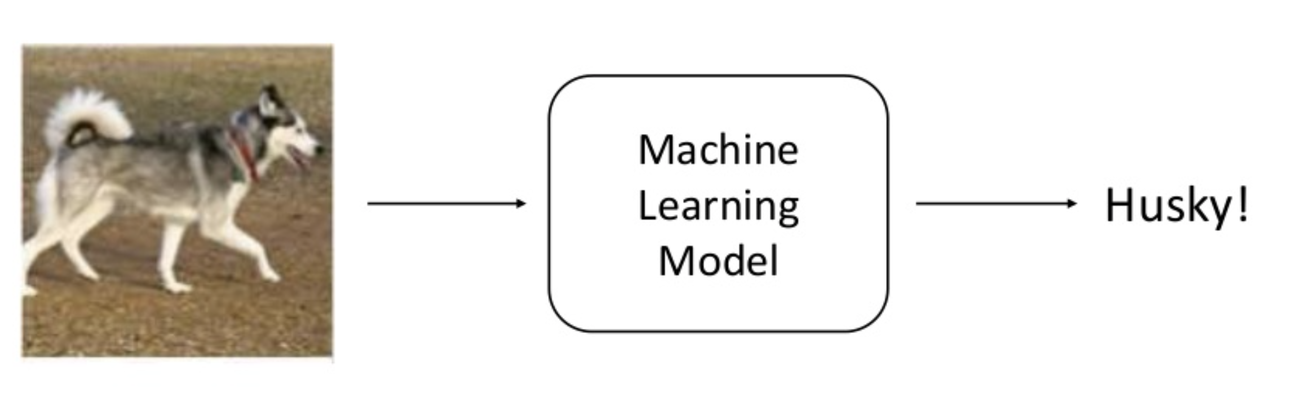
AI/ML Pitfalls
Having Too Much Confidence in Model Outcomes
Example: Classifier to recognize images as either Wolf or Husky
Sameer Singh UC Irvine https://www.slideshare.net/0xdata/explaining-blackbox-machine-learning-predictions

Slide 44
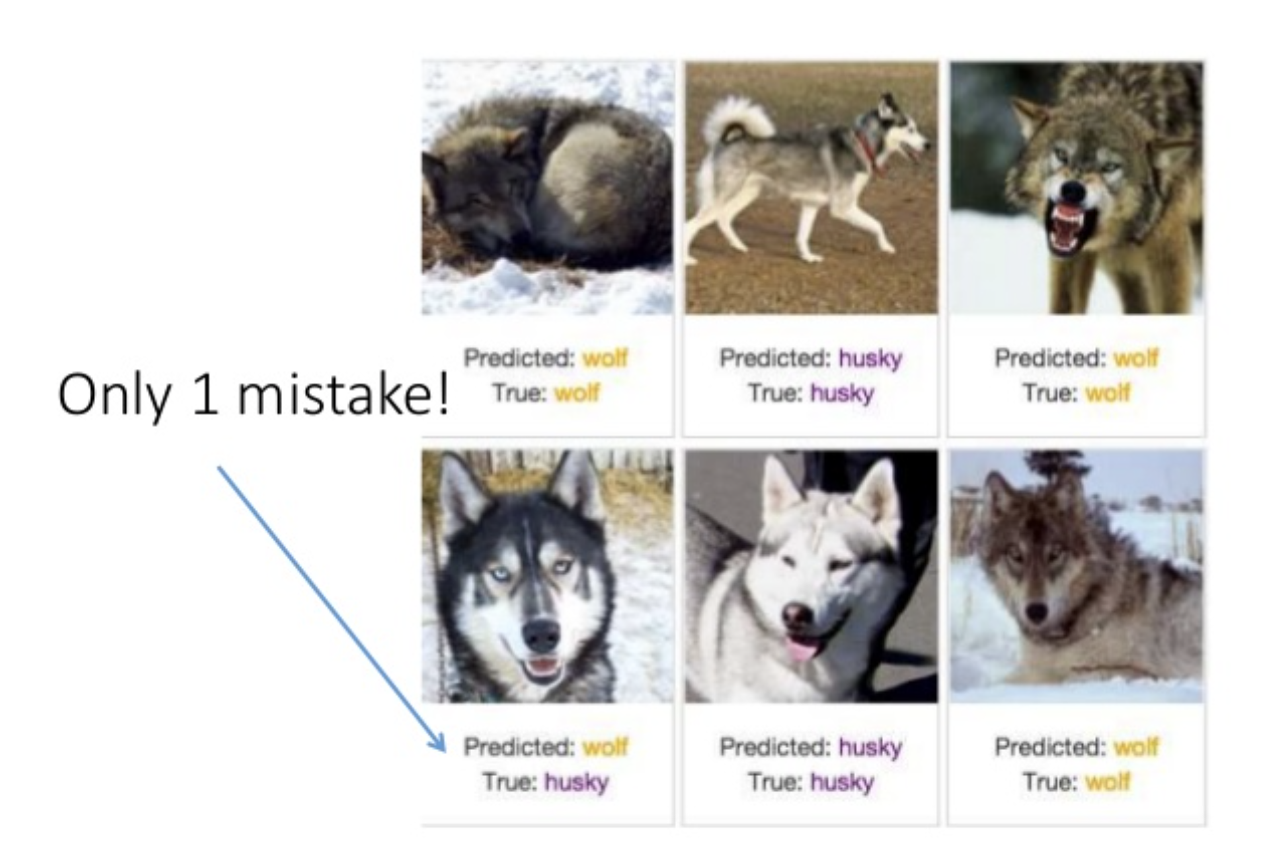
AI/ML Pitfalls
Having Too Much Confidence in Model Outcomes
Predictions indicate strong performance!
Does this mean we have a good model?
Sameer Singh UC Irvine https://www.slideshare.net/0xdata/explaining-blackbox-machine-learning-predictions

Slide 45
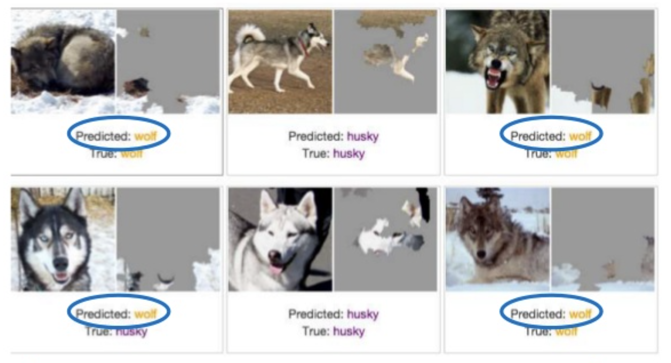
AI/ML Pitfalls
Having Too Much Confidence in Model Outcomes
Turns out, the model was recognising snow as the distinguishing feature for wolf!
Sameer Singh UC Irvine https://www.slideshare.net/0xdata/explaining-blackbox-machine-learning-predictions

Slide 46
Further Interest Topics
Model Interpretability
AI models are “black boxes”, but large research efforts are put into model explainability and interpretability.
Model Hosting and Scalability
Cost effective hosting strategies as models scale and use-cases grow.
Multi-model deployment, AWS AutoScaling, AWS DeepSpeed Inference.
Beyond AWS
AI/ML services on other cloud platforms like Google Cloud AI, Microsoft Azure AI, and even GitHub.

Slide 47
Thanks!
Questions and conversations: larry.huynh@uwa.edu.au

